Slide 1
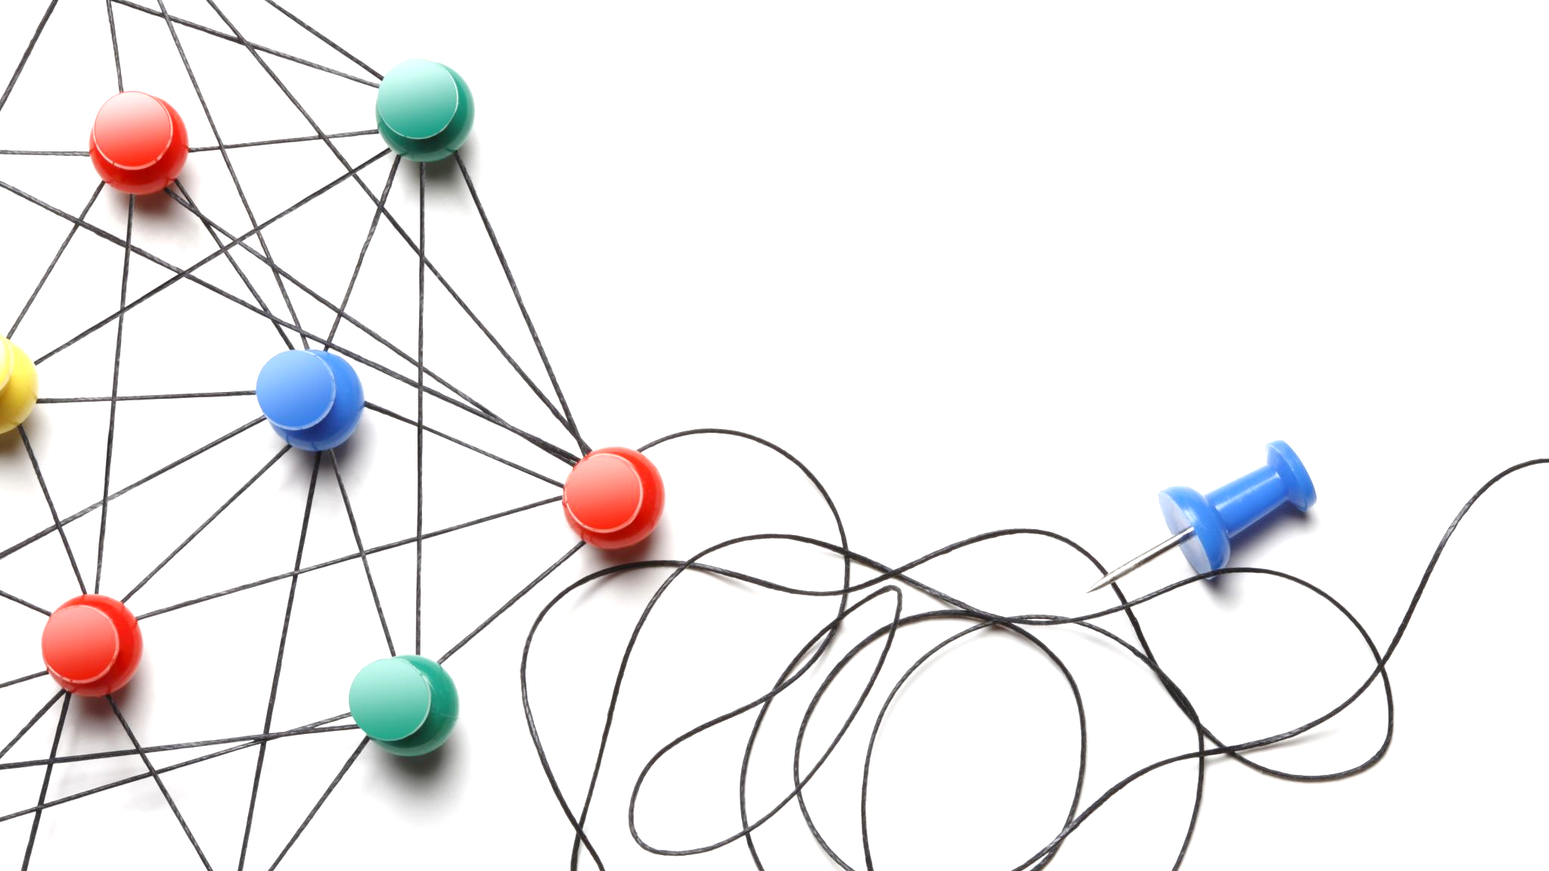
Configuring DJI RoboMaster for ROS Navigation Stack to generate map and navigate autonomously
Mobile Robotics Project

Slide 2

Presented by
Syed Muhammad Khalid |20060015
Syed Muhammad Alam | 21060007
Syed Meharullah |21060009

Slide 3
Introduction
A mobile robot is a machine controlled by software that use sensors and other technology to identify its surroundings and move around its environment.
There are applications of the autonomous mobile robot in many fields such as industry, space, defense and transportation etc.
For the autonomous operation of mobile robots, there are three important aspects : Navigation, Localization, and Mapping.

Slide 4
Navigation
The aim of navigation is to search an optimal or suboptimal path from the start point to the goal point with obstacle avoidance capability.
Navigation can further be classified into two types:
Global Navigation
Local Navigation
Notes:
When conducting research, it is easy to go to one source: Wikipedia. However, you need to include a variety of sources in your research. Consider the following sources:
Who can I interview to get more information on the topic?
Is the topic current and will it be relevant to my audience?
What articles, blogs, and magazines may have something related to my topic?
Is there a YouTube video on the topic? If so, what is it about?
What images can I find related to the topic?

Slide 5
Global vs Local Navigation
In Global Navigation, the prior knowledge of the environment should be available.
In local navigation, the robot can control its motion and orientation autonomously using equipped sensors.
Notes:
When conducting research, it is easy to go to one source: Wikipedia. However, you need to include a variety of sources in your research. Consider the following sources:
Who can I interview to get more information on the topic?
Is the topic current and will it be relevant to my audience?
What articles, blogs, and magazines may have something related to my topic?
Is there a YouTube video on the topic? If so, what is it about?
What images can I find related to the topic?

Slide 6
Localization and Mapping
In Localization, the robot determines its position(pose) in the environment .
In mapping, the robot controls its actions and maps the optimal trajectory.
Notes:
When conducting research, it is easy to go to one source: Wikipedia. However, you need to include a variety of sources in your research. Consider the following sources:
Who can I interview to get more information on the topic?
Is the topic current and will it be relevant to my audience?
What articles, blogs, and magazines may have something related to my topic?
Is there a YouTube video on the topic? If so, what is it about?
What images can I find related to the topic?

Slide 7
Configuring the Robot to generate a map using its on board sensors
Compatibility of the Robot with Ros Navigation Stack
Configuring the Robot to navigate autonomously in the mapped environment
Project Objectives
Notes:
When conducting research, it is easy to go to one source: Wikipedia. However, you need to include a variety of sources in your research. Consider the following sources:
Who can I interview to get more information on the topic?
Is the topic current and will it be relevant to my audience?
What articles, blogs, and magazines may have something related to my topic?
Is there a YouTube video on the topic? If so, what is it about?
What images can I find related to the topic?

Slide 8
Methodology
Configuring the Robomaster (EP-core) and the installed IR sensors to replicate a LIDAR sensor.
Configuring the Robot to implement Gmapping algorithm by creating:
Implementing ROS navigation stack to autonomously move the robot from initial position to goal position while avoiding obstacles.
scan topics
odometry topics
relevant transformations
gmapping parameter settings
Notes:
When conducting research, it is easy to go to one source: Wikipedia. However, you need to include a variety of sources in your research. Consider the following sources:
Who can I interview to get more information on the topic?
Is the topic current and will it be relevant to my audience?
What articles, blogs, and magazines may have something related to my topic?
Is there a YouTube video on the topic? If so, what is it about?
What images can I find related to the topic?

Slide 9
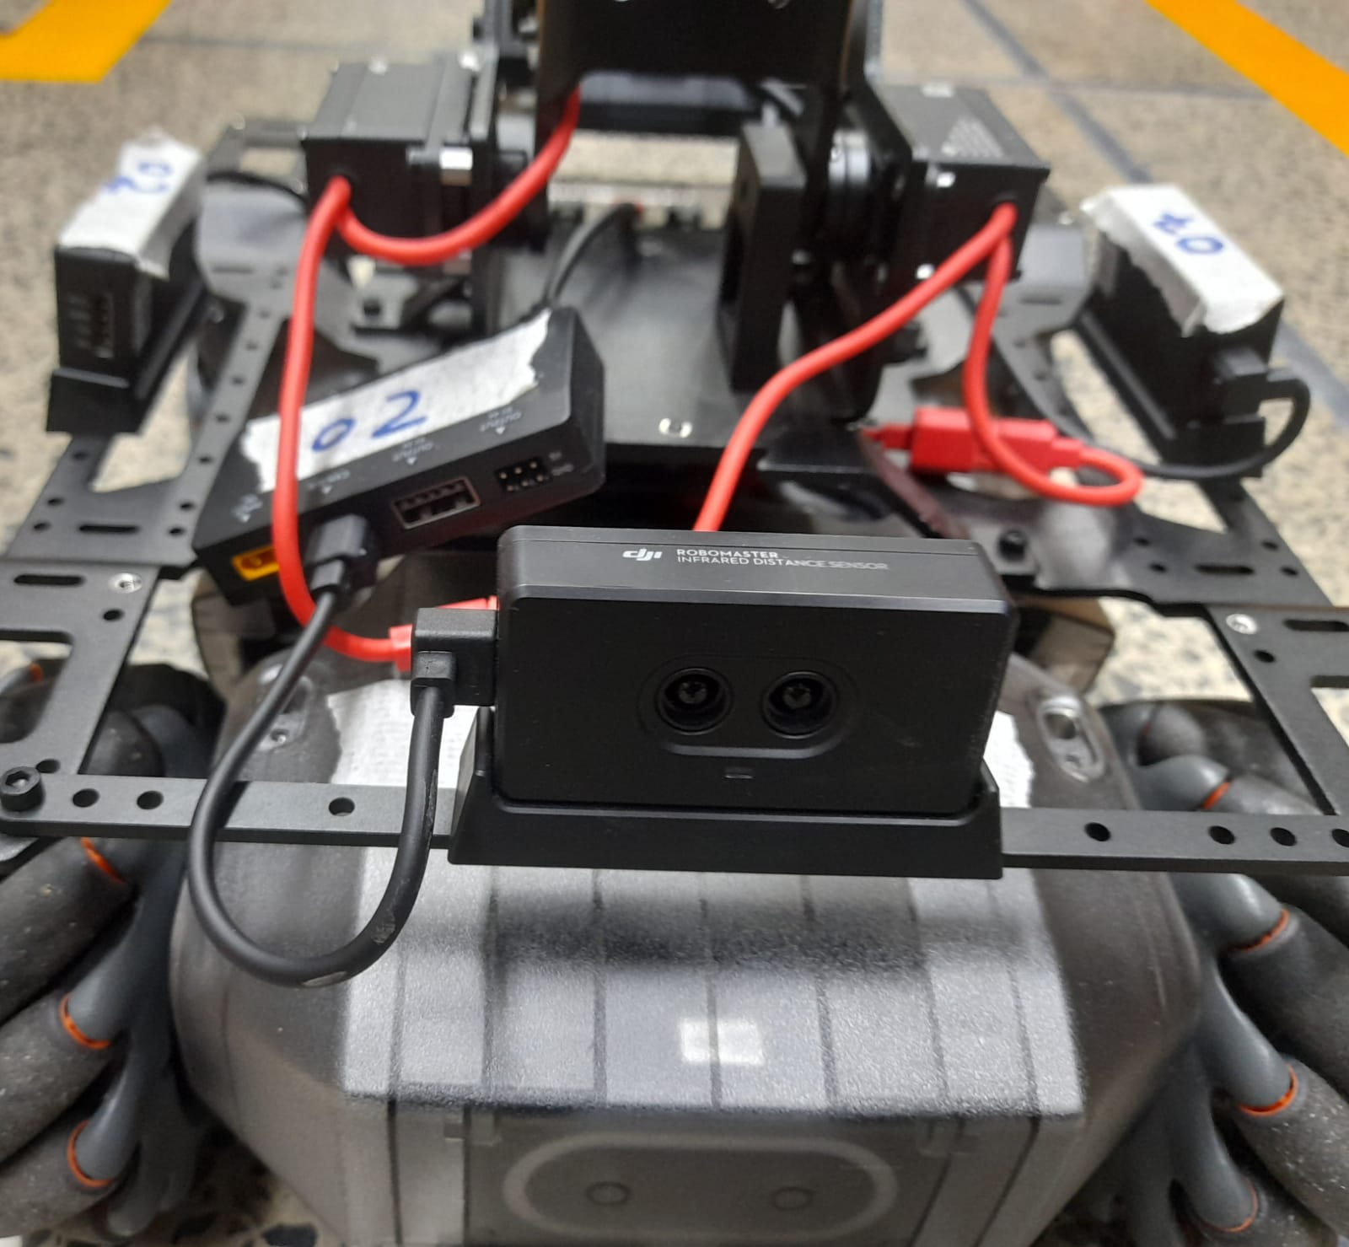
Configuring Robomaster
Right IR Sensor
Installing IR Sensors
The aim of these IR Sensors was to replicate the Lidar sensor.
Three IR sensor were placed at 90 degrees from each other.
Left IR Sensor
Front IR Sensor
Notes:
When conducting research, it is easy to go to one source: Wikipedia. However, you need to include a variety of sources in your research. Consider the following sources:
Who can I interview to get more information on the topic?
Is the topic current and will it be relevant to my audience?
What articles, blogs, and magazines may have something related to my topic?
Is there a YouTube video on the topic? If so, what is it about?
What images can I find related to the topic?

Slide 10
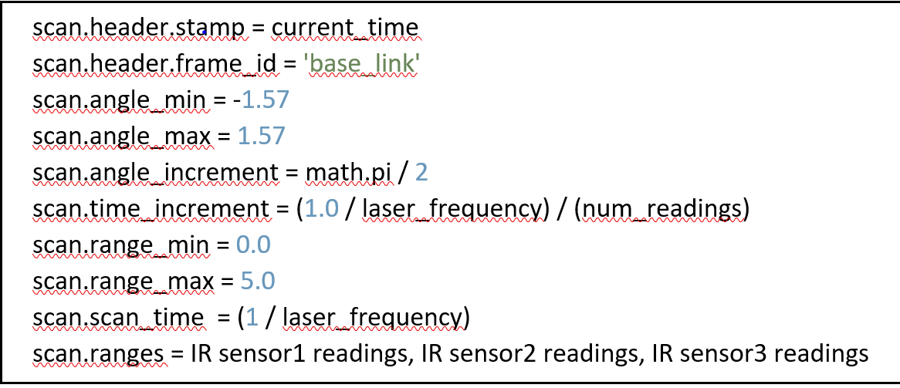
Configuring Robomaster
Creating /Scan Topic
The following were the parameters that were included in the LaserScan message or /scan topic
Notes:
When conducting research, it is easy to go to one source: Wikipedia. However, you need to include a variety of sources in your research. Consider the following sources:
Who can I interview to get more information on the topic?
Is the topic current and will it be relevant to my audience?
What articles, blogs, and magazines may have something related to my topic?
Is there a YouTube video on the topic? If so, what is it about?
What images can I find related to the topic?

Slide 11
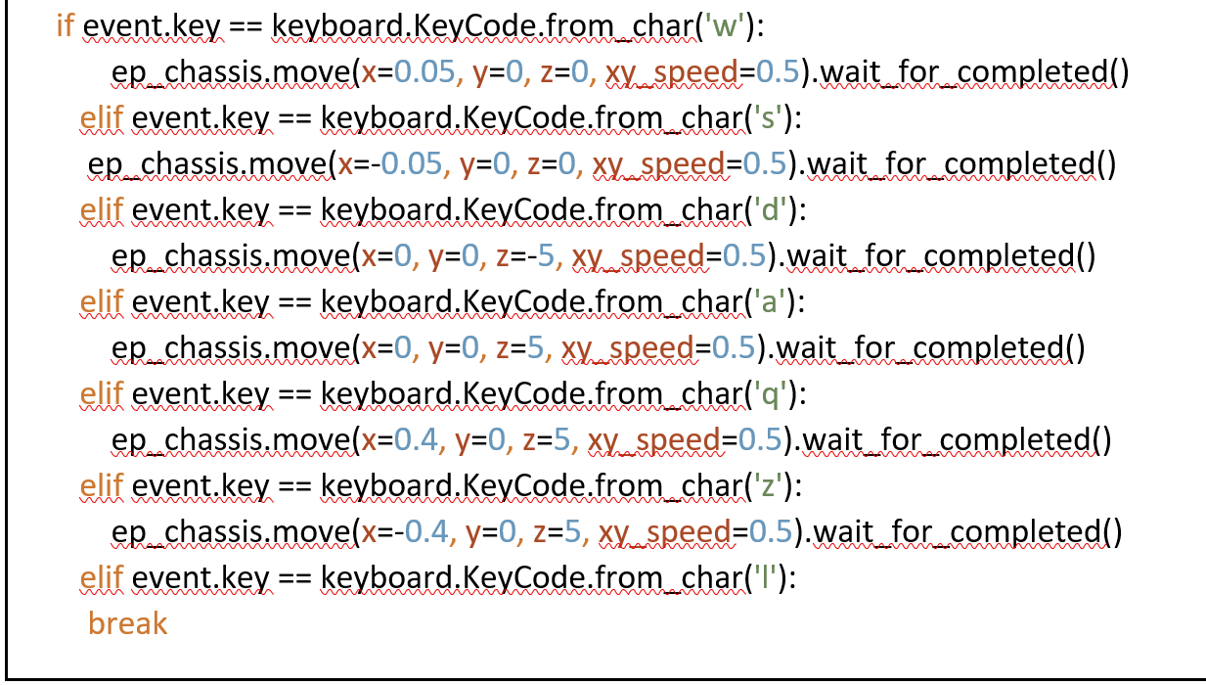
Configuring Robomaster
Implementing Keyboard
The pseudo code that was implemented for the movement of the Robot using keyboard
Notes:
When conducting research, it is easy to go to one source: Wikipedia. However, you need to include a variety of sources in your research. Consider the following sources:
Who can I interview to get more information on the topic?
Is the topic current and will it be relevant to my audience?
What articles, blogs, and magazines may have something related to my topic?
Is there a YouTube video on the topic? If so, what is it about?
What images can I find related to the topic?

Slide 12
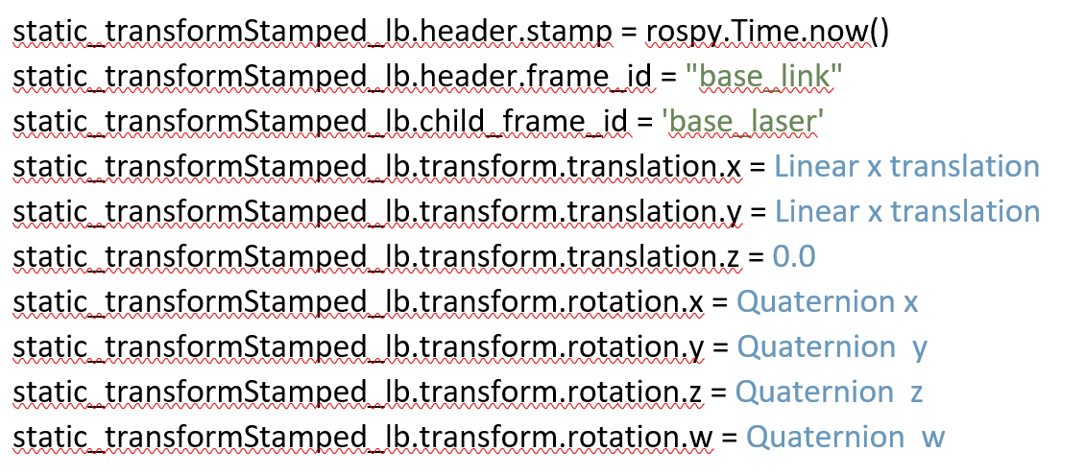
Gmapping Implementation
Gmapping configuration
The gmapping algorithm requires scan data and transformation data as input
To perform transformations, two different type of transformations were used:
Tf2
Tf2_static
Notes:
When conducting research, it is easy to go to one source: Wikipedia. However, you need to include a variety of sources in your research. Consider the following sources:
Who can I interview to get more information on the topic?
Is the topic current and will it be relevant to my audience?
What articles, blogs, and magazines may have something related to my topic?
Is there a YouTube video on the topic? If so, what is it about?
What images can I find related to the topic?

Slide 13
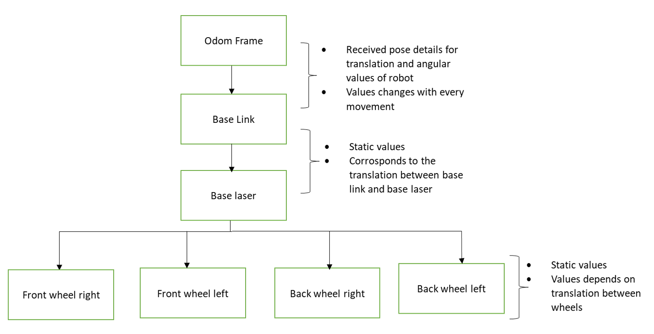
Gmapping Implementation
Transformation of frames
There are total 7 frames
Notes:
When conducting research, it is easy to go to one source: Wikipedia. However, you need to include a variety of sources in your research. Consider the following sources:
Who can I interview to get more information on the topic?
Is the topic current and will it be relevant to my audience?
What articles, blogs, and magazines may have something related to my topic?
Is there a YouTube video on the topic? If so, what is it about?
What images can I find related to the topic?

Slide 14
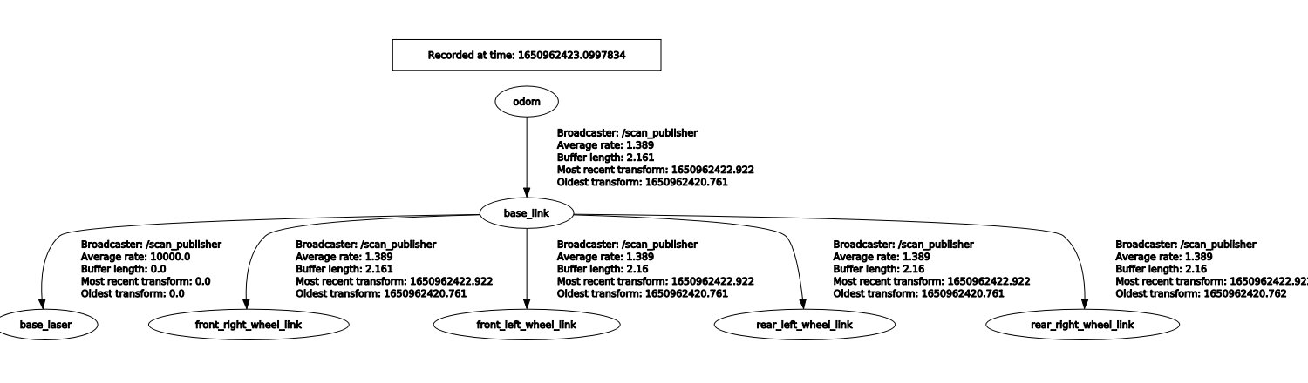
Rqt tree Diagram
Notes:
When conducting research, it is easy to go to one source: Wikipedia. However, you need to include a variety of sources in your research. Consider the following sources:
Who can I interview to get more information on the topic?
Is the topic current and will it be relevant to my audience?
What articles, blogs, and magazines may have something related to my topic?
Is there a YouTube video on the topic? If so, what is it about?
What images can I find related to the topic?

Slide 15
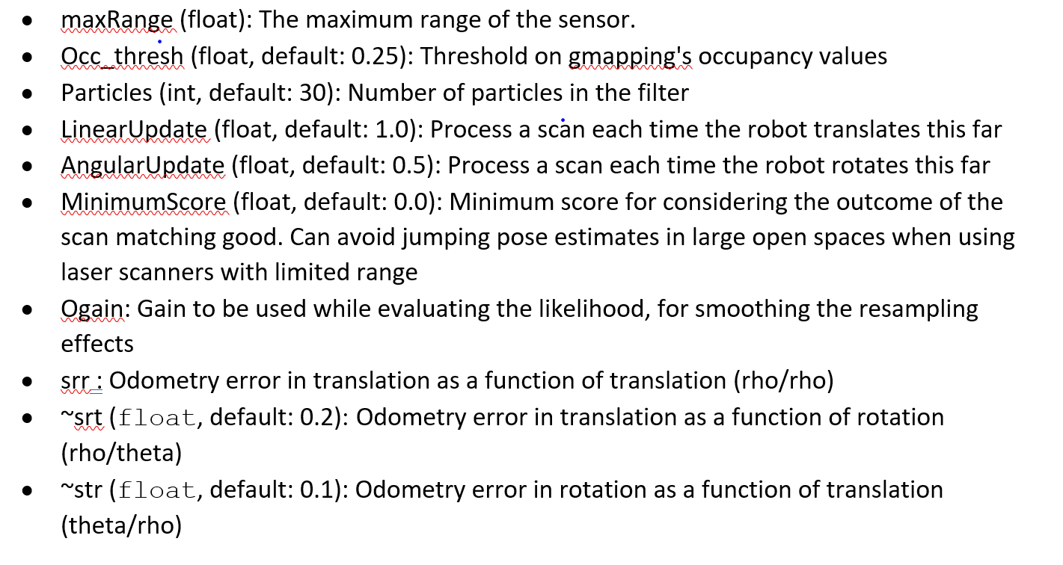
Gmapping parameters
Following are the different parameters of the gmapping algorithm:
Notes:
When conducting research, it is easy to go to one source: Wikipedia. However, you need to include a variety of sources in your research. Consider the following sources:
Who can I interview to get more information on the topic?
Is the topic current and will it be relevant to my audience?
What articles, blogs, and magazines may have something related to my topic?
Is there a YouTube video on the topic? If so, what is it about?
What images can I find related to the topic?

Slide 16
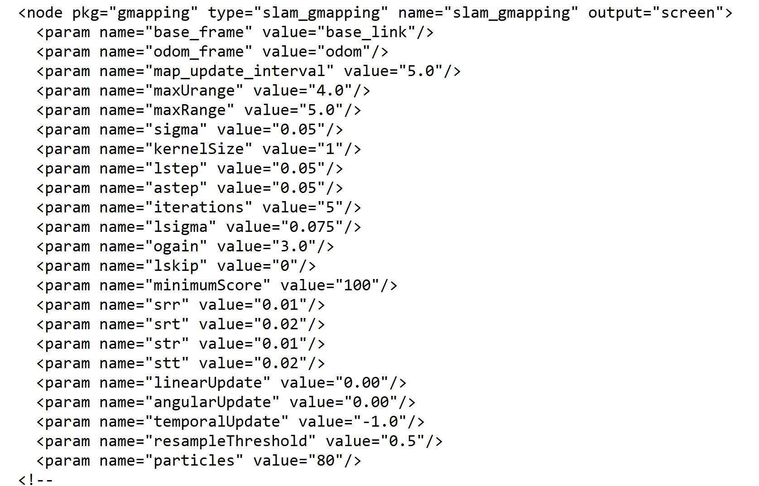
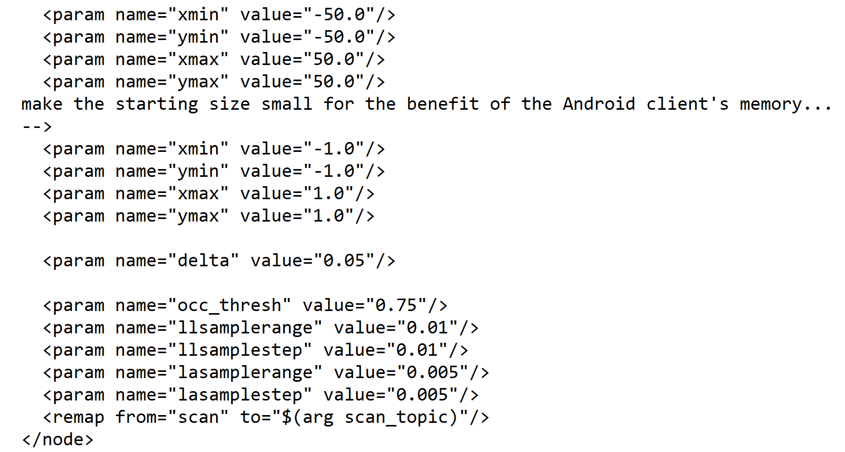
Gmapping parameters
Gmapping parameters
Following are the different parameters set in launch file of gmapping algorithm:
Setting gmapping parameter values in a launch file as :
Notes:
When conducting research, it is easy to go to one source: Wikipedia. However, you need to include a variety of sources in your research. Consider the following sources:
Who can I interview to get more information on the topic?
Is the topic current and will it be relevant to my audience?
What articles, blogs, and magazines may have something related to my topic?
Is there a YouTube video on the topic? If so, what is it about?
What images can I find related to the topic?

Slide 17
Navstack Implementation
Navstack configuration
It takes information from odometry and goal pose.
It outputs safe-velocity to reach the desired point in the map.
The ROS Navigation Stack uses two costmaps to store information about obstacles in the world map.
Global costmap: it is used to generate long term plans over the entire environment.
Local costmap: it is used to generate short term plans over the environment. i.e. to avoid obstacles.
Notes:
When conducting research, it is easy to go to one source: Wikipedia. However, you need to include a variety of sources in your research. Consider the following sources:
Who can I interview to get more information on the topic?
Is the topic current and will it be relevant to my audience?
What articles, blogs, and magazines may have something related to my topic?
Is there a YouTube video on the topic? If so, what is it about?
What images can I find related to the topic?

Slide 18
Navstack Implementation
Navstack works on the principle of Dynamic Window Approach (DWA) algorithm
Dynamic Window Approach (DWA) algorithm working:
Discretely sample in the robot's control space (dx,dy,dtheta)
For each sampled velocity, perform forward simulation to predict what would happen for some (short) period of time.
Evaluate (score) each trajectory resulting from the forward simulation,
Pick the highest-scoring trajectory and send the associated velocity to the mobile base.
Rinse and repeat.
Notes:
When conducting research, it is easy to go to one source: Wikipedia. However, you need to include a variety of sources in your research. Consider the following sources:
Who can I interview to get more information on the topic?
Is the topic current and will it be relevant to my audience?
What articles, blogs, and magazines may have something related to my topic?
Is there a YouTube video on the topic? If so, what is it about?
What images can I find related to the topic?

Slide 19
Navstack Implementation
Move base node working
The move base node is responsible for planning a collision-free path from a starting location to a goal location for a mobile robot.
The move-base node subscribes to the following topics:
/move_base_simple/goal : Goal position and orientation
The publisher will publish to the topic:
/cmd_vel : Linear and angular velocity command
Notes:
When conducting research, it is easy to go to one source: Wikipedia. However, you need to include a variety of sources in your research. Consider the following sources:
Who can I interview to get more information on the topic?
Is the topic current and will it be relevant to my audience?
What articles, blogs, and magazines may have something related to my topic?
Is there a YouTube video on the topic? If so, what is it about?
What images can I find related to the topic?

Slide 20

Rviz visualization of Sensor Readings
Outputs of 3 IR Sensors
Front IR Sensor
Right IR Sensor
Left IR Sensor
Robot’s location
Notes:
When conducting research, it is easy to go to one source: Wikipedia. However, you need to include a variety of sources in your research. Consider the following sources:
Who can I interview to get more information on the topic?
Is the topic current and will it be relevant to my audience?
What articles, blogs, and magazines may have something related to my topic?
Is there a YouTube video on the topic? If so, what is it about?
What images can I find related to the topic?

Slide 21
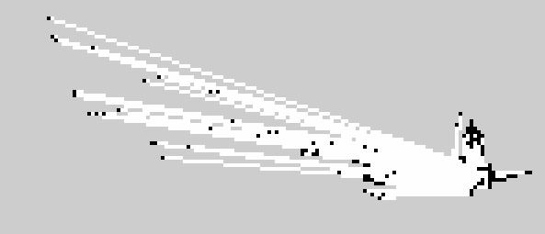
Rviz visualization of Sensor Readings
Outputs of 3 IR Sensors
Front IR Sensor
Left IR Sensor
Right IR Sensor
Notes:
When conducting research, it is easy to go to one source: Wikipedia. However, you need to include a variety of sources in your research. Consider the following sources:
Who can I interview to get more information on the topic?
Is the topic current and will it be relevant to my audience?
What articles, blogs, and magazines may have something related to my topic?
Is there a YouTube video on the topic? If so, what is it about?
What images can I find related to the topic?

Slide 22
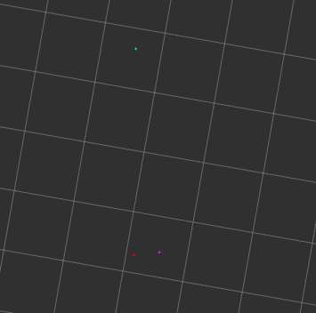
Rviz results
Outputs of 3 IR Sensors
Front IR Sensor
Left IR Sensor
Right IR Sensor
Notes:
When conducting research, it is easy to go to one source: Wikipedia. However, you need to include a variety of sources in your research. Consider the following sources:
Who can I interview to get more information on the topic?
Is the topic current and will it be relevant to my audience?
What articles, blogs, and magazines may have something related to my topic?
Is there a YouTube video on the topic? If so, what is it about?
What images can I find related to the topic?

Slide 23
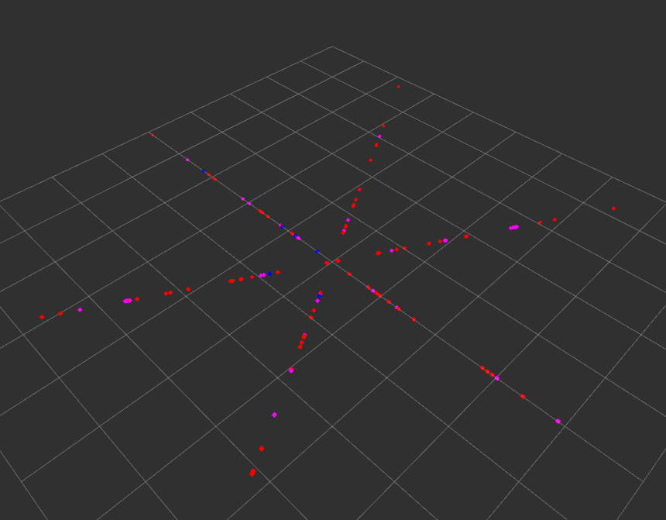
Rviz Output results
Initially IR sensors readings after some rotations
Notes:
When conducting research, it is easy to go to one source: Wikipedia. However, you need to include a variety of sources in your research. Consider the following sources:
Who can I interview to get more information on the topic?
Is the topic current and will it be relevant to my audience?
What articles, blogs, and magazines may have something related to my topic?
Is there a YouTube video on the topic? If so, what is it about?
What images can I find related to the topic?

Slide 24
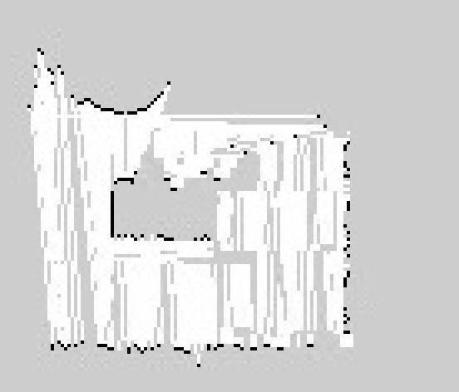
Rviz results
Map of the Arena
Notes:
When conducting research, it is easy to go to one source: Wikipedia. However, you need to include a variety of sources in your research. Consider the following sources:
Who can I interview to get more information on the topic?
Is the topic current and will it be relevant to my audience?
What articles, blogs, and magazines may have something related to my topic?
Is there a YouTube video on the topic? If so, what is it about?
What images can I find related to the topic?

Slide 25
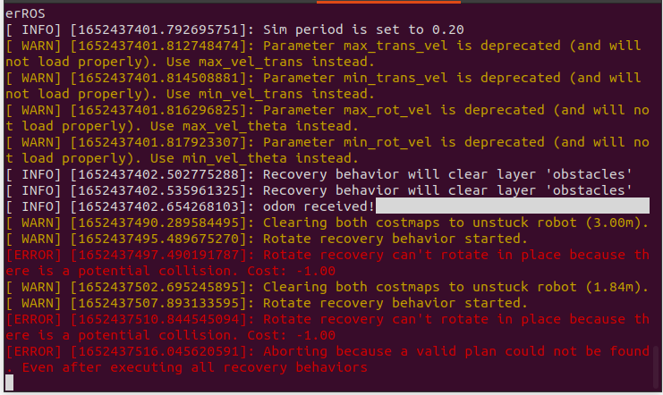
Output results
Navstack running
Notes:
When conducting research, it is easy to go to one source: Wikipedia. However, you need to include a variety of sources in your research. Consider the following sources:
Who can I interview to get more information on the topic?
Is the topic current and will it be relevant to my audience?
What articles, blogs, and magazines may have something related to my topic?
Is there a YouTube video on the topic? If so, what is it about?
What images can I find related to the topic?

Slide 26
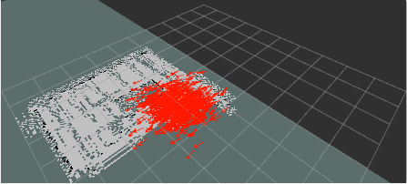
Output results
Pose array of Navstack on Rviz
Notes:
When conducting research, it is easy to go to one source: Wikipedia. However, you need to include a variety of sources in your research. Consider the following sources:
Who can I interview to get more information on the topic?
Is the topic current and will it be relevant to my audience?
What articles, blogs, and magazines may have something related to my topic?
Is there a YouTube video on the topic? If so, what is it about?
What images can I find related to the topic?

Slide 27
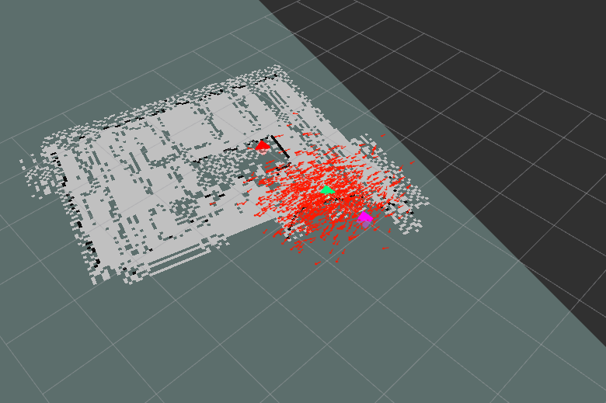
Output results
Local Navigation
Notes:
When conducting research, it is easy to go to one source: Wikipedia. However, you need to include a variety of sources in your research. Consider the following sources:
Who can I interview to get more information on the topic?
Is the topic current and will it be relevant to my audience?
What articles, blogs, and magazines may have something related to my topic?
Is there a YouTube video on the topic? If so, what is it about?
What images can I find related to the topic?

Slide 28
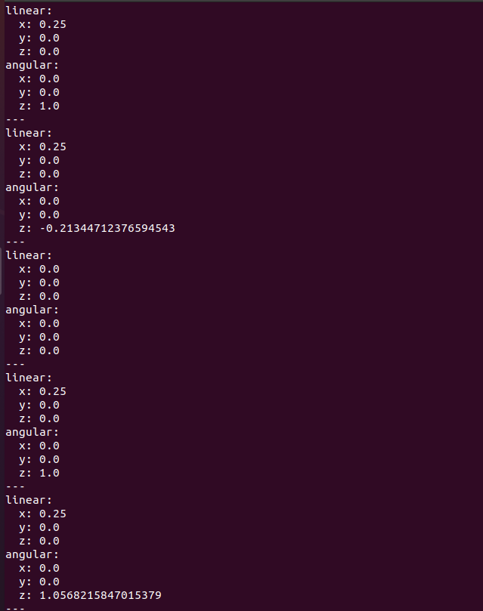
Output results
Navstack result(changing Velocities)
Notes:
When conducting research, it is easy to go to one source: Wikipedia. However, you need to include a variety of sources in your research. Consider the following sources:
Who can I interview to get more information on the topic?
Is the topic current and will it be relevant to my audience?
What articles, blogs, and magazines may have something related to my topic?
Is there a YouTube video on the topic? If so, what is it about?
What images can I find related to the topic?

Slide 29
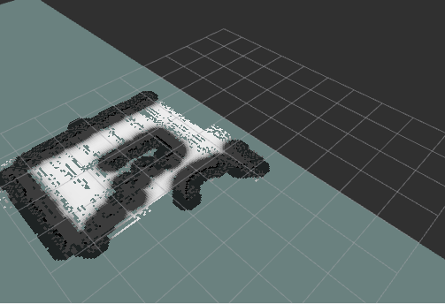
Output results
Local cost map
Notes:
When conducting research, it is easy to go to one source: Wikipedia. However, you need to include a variety of sources in your research. Consider the following sources:
Who can I interview to get more information on the topic?
Is the topic current and will it be relevant to my audience?
What articles, blogs, and magazines may have something related to my topic?
Is there a YouTube video on the topic? If so, what is it about?
What images can I find related to the topic?

Slide 30
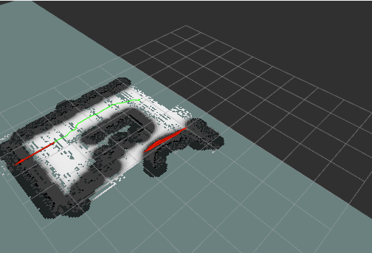
Output results
Odometry for initial and goal position with path planning on Rviz
Notes:
When conducting research, it is easy to go to one source: Wikipedia. However, you need to include a variety of sources in your research. Consider the following sources:
Who can I interview to get more information on the topic?
Is the topic current and will it be relevant to my audience?
What articles, blogs, and magazines may have something related to my topic?
Is there a YouTube video on the topic? If so, what is it about?
What images can I find related to the topic?

Slide 31
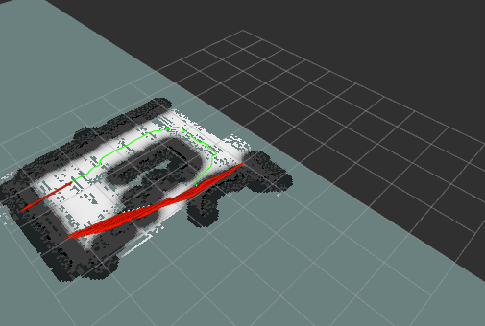
Output results
Local Navigation
Notes:
When conducting research, it is easy to go to one source: Wikipedia. However, you need to include a variety of sources in your research. Consider the following sources:
Who can I interview to get more information on the topic?
Is the topic current and will it be relevant to my audience?
What articles, blogs, and magazines may have something related to my topic?
Is there a YouTube video on the topic? If so, what is it about?
What images can I find related to the topic?

Slide 32
References
[1] R. Smith’, M. Self^, and P. Cheesemans, “Estimating Uncertain Spatial Relationships in Robotics*.”
[2] G. Dissanayake, H. Durrant-Whyte, and T. Bailey, “Computationally efficient solution to the simultaneous localisation and map building (SLAM) problem,” Proc. - IEEE Int. Conf. Robot. Autom., vol. 2, pp. 1009–1014, 2000, doi: 10.1109/ROBOT.2000.844732.
[3] H. Durrant-Whyte, S. Majumder, S. Thrun, M. de Battista, and S. Scheding, “A Bayesian Algorithm for Simultaneous Localisation and Map Building,” pp. 49–60, 2003, doi: 10.1007/3-540-36460-9_4.
[4] J. J. Leonard, H. Jacob, and S. Feder, “A Computationally Efficient Method for Large-Scale Concurrent Mapping and Localization.”
[5] H. Hexmoor and M. M. Matari´c, “A Probabilistic Approach to Concurrent Mapping and Localization for Mobile Robots,” Accessed: May 13, 2022. [Online]. Available: http://www.cs.cmu.edu/thrunhttp://www.cs.uni-bonn.de/wolframhttp://www.cs.uni-bonn.de/fox.
[6] M. Csorba, “Simultaneous Localisation and Map Building.”
[7] J. A. Castellanos and J. D. Tardós, “Mobile Robot Localization and Map Building,” Mob. Robot Localization Map Build., 1999, doi: 10.1007/978-1-4615-4405-0.
[8] A. P. Dempster, N. M. Laird, and D. B. Rubin, “Maximum Likelihood from Incomplete Data Via the EM Algorithm,” J. R. Stat. Soc. Ser. B, vol. 39, no. 1, pp. 1–22, Sep. 1977, doi: 10.1111/J.2517-6161.1977.TB01600.X.
[9] G. J. McLachlan and T. (Thriyambakam) Krishnan, “The EM algorithm and extensions,” p. 359.
[10] L. Iocchi, K. Konolige, and M. Bajracharya, “Visually Realistic Mapping of a Planar Environment with Stereo,” 2000.
Notes:
After consulting a variety of sources, you will need to narrow your topic. For example, the topic of internet safety is huge, but you could narrow that topic to include internet safety in regards to social media apps that teenagers are using heavily. A topic like that is more specific and will be relevant to your peers. Some questions to think about to help you narrow your topic:
What topics of the research interest me the most?
What topics of the research will interest my audience the most?
What topics will the audience find more engaging? Shocking? Inspiring?

